Slide 1
Глагол «to be»
Быть, являться, находиться
болу

Slide 2
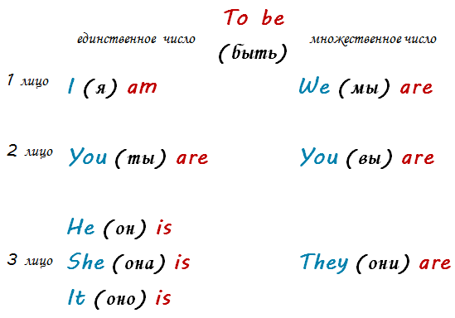
Формы глагола «to be»

Slide 3
Глагол to be (быть) используется, чтобы сказать, к примеру: Я умный, ты красивая, мы друзья, вы где
To be етістікпен қолданылатын мысалдар: Мен ақылдымын, сен сұлусың, біз доспыз, сіз қайдасыз.
Я устал. Мен шаршадым.
Ты права. Сенікі дұрыс.
Мы друзья. Біз доспыз.
Он счастлив. Ол баққыты.
Она дома. Ол үйде.
Они известные. Олар танымал.
Это вкусно. Бұл дәмді.
I am tired.
You are right.
We are friends.
He is happy.
She is at home.
They are famous.
It is delicious.

Slide 4
Формы глагола to be можно использовать не только с местоимениями, но и с полноценными существительными
To be тек қана есімдікпен ғана емес, зат есіммен де қолданыла алады
- Мальчики дома.
Балалар үйде.
- Мистер Браун старый.
Мистер Браун кәрі адам.
- Ребекка преподаватель.
Ребекка оқытушы.
- Стулья удобные.
Орындықтар ыңғайлы.
Билеты дорогие
Билеттер қымбат.
The boys are at home.
Mr. Brown is old.
Rebecca is a teacher.
The chairs are comfortable.
The tickets are expensive.

Slide 5

Negative sentences with TO BE
Отрицательные предложения с глаголом TO BE
Болымсыз сөйлемдер
You
We
They
He
She
It
I
are
is
am
aren’t
isn’t
I’m not
not
not
not
You are not (aren’t) my friend.
We are not (aren’t) happy at work.
They are not (aren’t) cheap.
He is not (isn’t) hungry.
She is not (isn’t) busy.
It is not (isn’t) correct answer.
I am not (I’m not) tired.

Slide 6
General questions with TO BE
Общие вопросы с глаголом TO BE
Жалпы сұрақтар
Are
Am
Is
You are my friend.
We are happy at work.
They are cheap.
He is hungry.
She is busy.
It is correct answer.
I am tired.
Are you my friend?
Yes, I am./ No, I am not.
Are we happy at work?
Yes, we are./ No, we are not.
Are they cheap?
Yes, they are./ No, they are not.
Is he hungry?
Yes, he is./ No, he is not.
Is she busy?
Yes, she is./ No, she is not.
Is it correct answer?
Yes, it is./ No, it is not.
Am I tired?
Yes, I am./ No, I am not.

Slide 7
Составьте отрицательные предложения
Make up negative sentences
Болымсыз сөйлемдерді құрастырыңыз
I am tired.
You are right.
We are friends.
He is happy.
She is at home.
They are famous.
It is delicious.

Slide 8
Составьте отрицательные предложения
Make up negative sentences
Болымсыз сөйлемдерді құрастырыңыз
I am tired.
You are right.
We are friends.
He is happy.
She is at home.
They are famous.
It is delicious.
I am not tired. – I’m not tired.
You are not right. – You aren’t right
We are not friends.- We aren’t friends.
He is not happy. - He isn’t happy.
She is not at home. She isn’t at home
They are not famous. They aren’t famous.
It is not delicious. It isn’t delicious.

Slide 9
Составьте вопросительные предложения
Make up questions
Сұраулы сөйлемдерді құрастырыңыз
I am tired.
You are right.
We are friends.
He is happy.
She is at home.
They are famous.
It is delicious.

Slide 10
Составьте вопросительные предложения
Make up questions
Сұраулы сөйлемдерді құрастырыңыз
I am tired.
You are right.
We are friends.
He is happy.
She is at home.
They are famous.
It is delicious.
Am I tired? – Yes, I am./ No, I am not.
Are you right? – Yes, I am./ No, I am not.
Are we friends?- Yes, we are./ No, we are not.
Is he happy? - Yes, he is./ No, he is not.
Is she at home? Yes, she is./ No, she is not.
Are they famous? Yes, they are./ No, they are not.
Is it delicious? Yes, it is./ No, it is not.

Slide 11
Answer the following questions.
Ответьте на следующие вопросы по образцу
Келесі сұрақтарға жауап беріңіз
What is your name?
How old are you?
What is your nationality?
Where are you from?
What is your family?
What is your job?
Are you always right?
What is your favorite colour?
What is your favorite food?

